Slide 1

Community Life Engagement as a Pathway to, and Wrap-around for, Employment
Quarterly Provider Training Series
May 25, 2023
Notes:
Staci

Slide 2





Notes:
Staci
About MTI
Partners in this project include:
Quillo
The Arc Minnesota
Institute on Community Integration at the University of Minnesota
Institute for Community Inclusion at University of Massachusetts Boston
Strengths at Work LLC

Slide 3
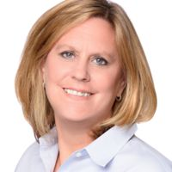
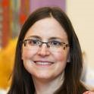


Introductions
Karen Lee, MS, SEEC, Inc.
klee@seeconline.org ​
Jennifer Sulewski, PhD, University of New Hampshire​
js1870@usnh.edu
Notes:
Staci- introductions

Slide 4
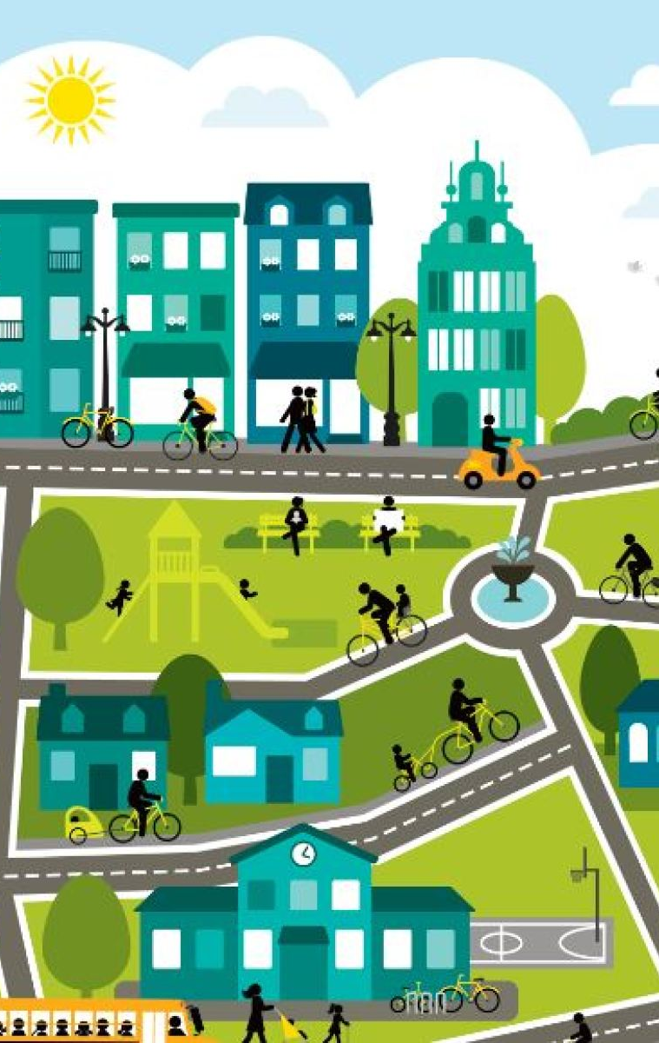
What is
Community Life Engagement
(CLE)?
All the ways that people with IDD access and participate in their communities, outside of employment, as part of a meaningful day. ​
An outcome, not a service
Non-work​
Accessing typical community facilities (library, gym, rec center, etc.)​
Volunteerism ​
Post-secondary &/or continuing education​
This Photo by Unknown author is licensed under CC BY-NC.
Notes:
Jen
An outcome, not a service
All the ways that people with IDD access and participate in their communities, outside of employment, as part of a meaningful day.
Non-work
Accessing typical community facilities (library, gym, rec center, etc.)
Volunteerism
Post-secondary &/or continuing education
Wrap-around to work
Pathway to work
Retirement activities

Slide 5
How does CLE relate to employment?
Leads to employment through career exploration & networking
Wraps around employment to fill gaps in time, experience, social connection
Supports people in retirement in integrated ways
Notes:
Jen
In addition to having value in its own way, CLE relates to work in these ways

Slide 6
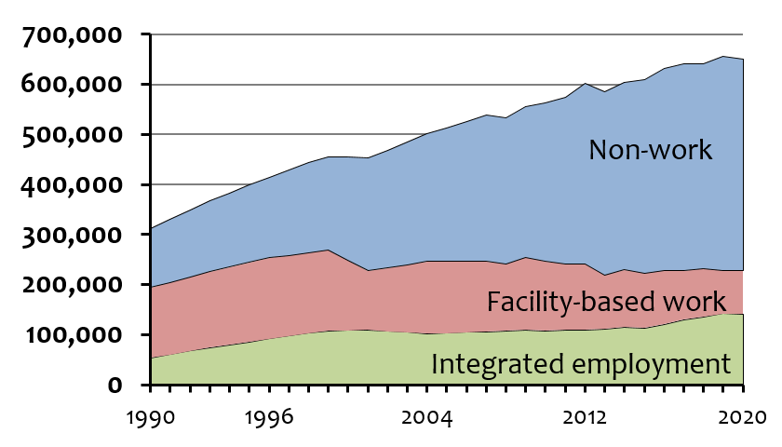
Numbers in Non-Work vs Employment
https://www.statedata.info/sites/statedata.info/files/files/bluebook_2022_complete_F.pdf
Notes:
Jen

Slide 7

ICI Research on Community Life Engagement
2014-2015 | Expert Interviews
2015-2016 | Provider case studies Developed guideposts and toolkit
2016-2017 | Piloted guideposts and toolkit with 7 providers in 2 states
2019-2022 | Developed Guideposts Fidelity Scale and online modules for service providers
Notes:
Jen

Slide 8
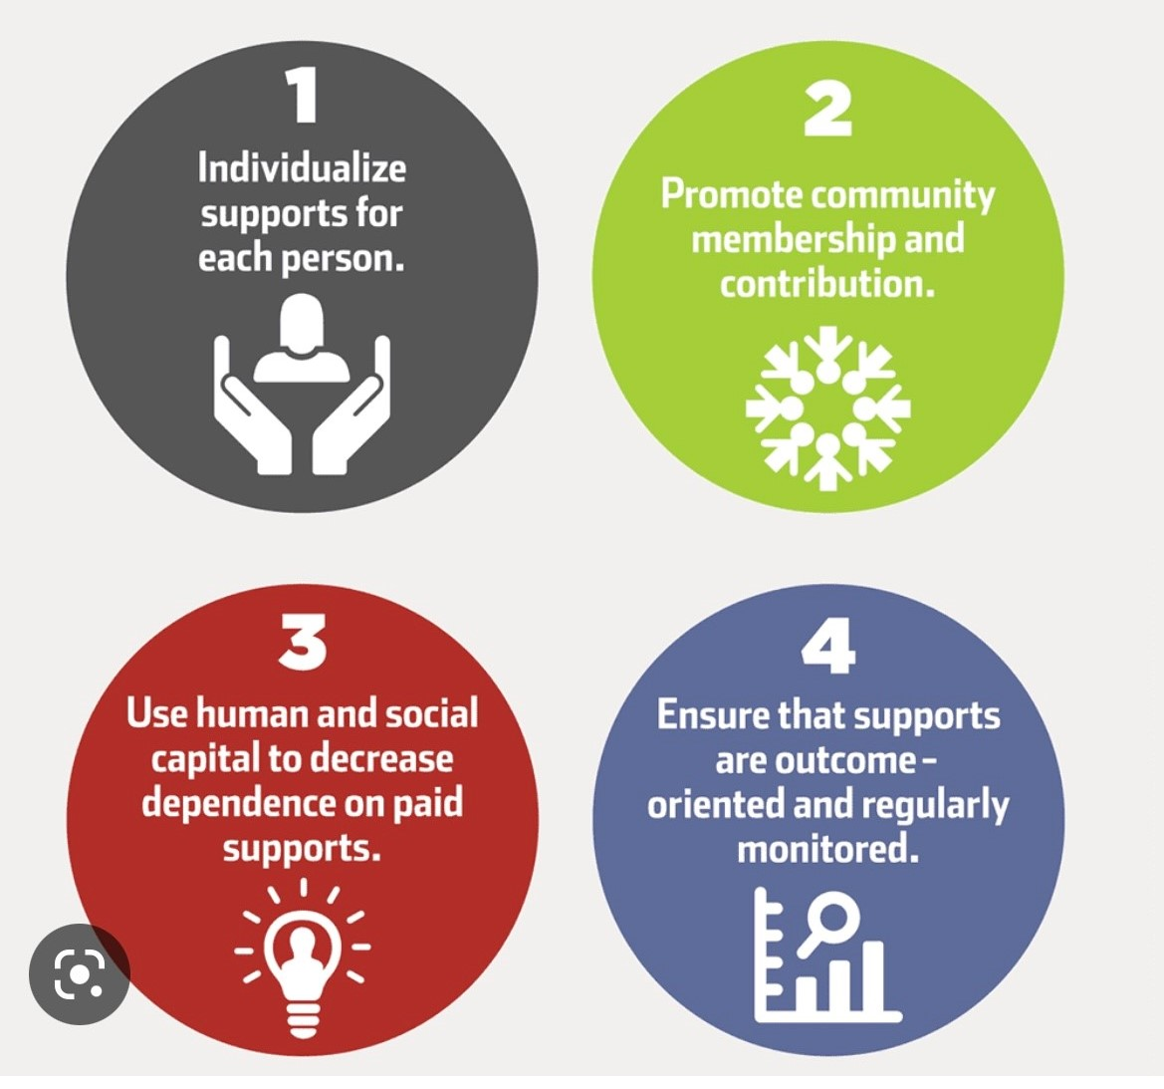
Guideposts of Support
https://cletoolkit.communityinclusion.org/
Notes:
Jen
From this research came the 4 guideposts, the toolkit...

Slide 9
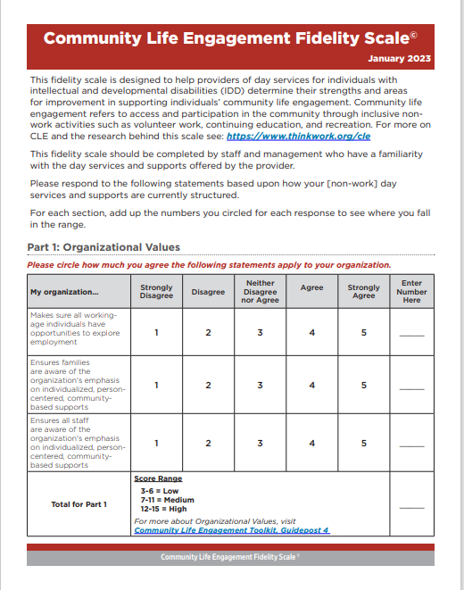
Community Life Engagement
Fidelity Scale
Use as a self- assessment tool
Completed by staff and management
Answer based on how your day services are currently structured
https://www.communityinclusion.org/files/cle-toolkit/guideposts_assessment.pdf
Notes:
Jen
… and most recently the CLEFS.

Slide 10
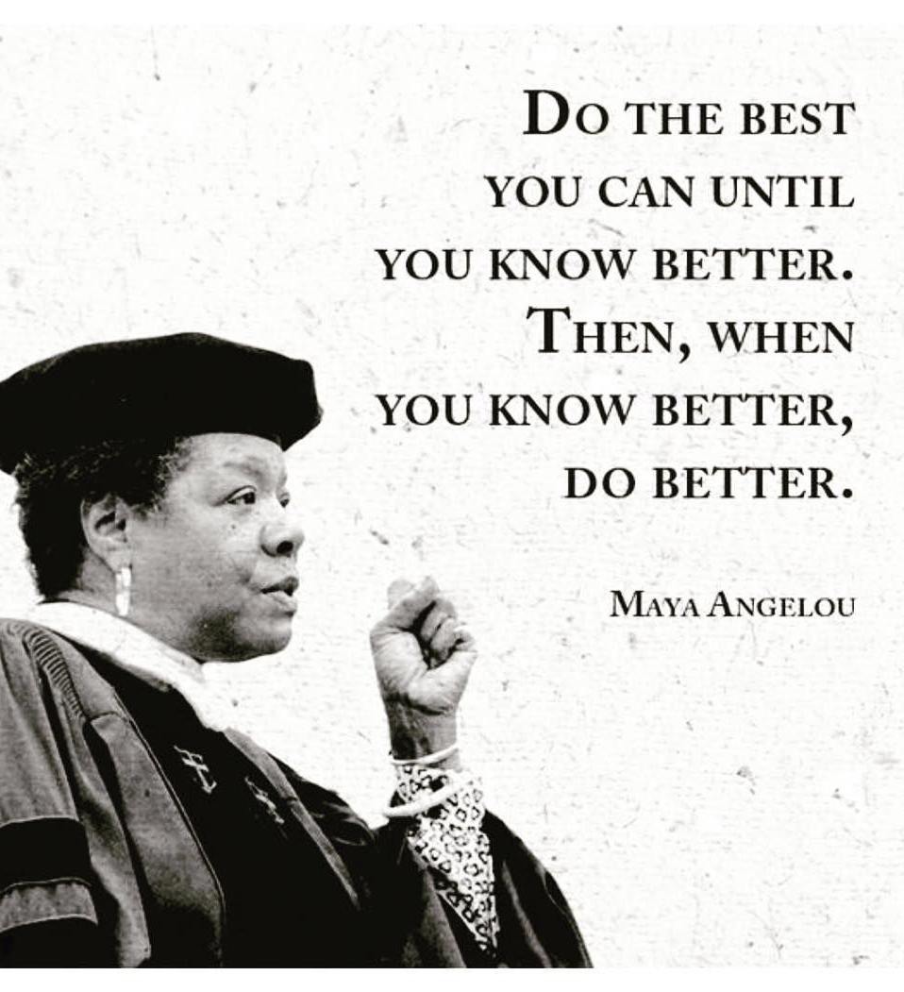
Notes:
Karen

Slide 11
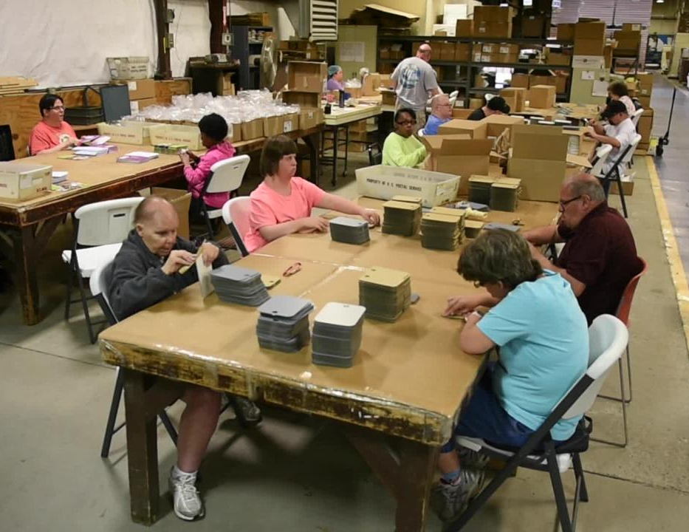
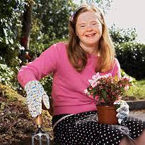
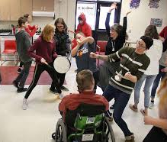
History of Community Engagement
Program without walls
Community Grants
Community Classes
Center based services serving as “hubs”
Leaving center based service to volunteer
Notes:
Karen

Slide 12

get to know the person! use person centered planning find ways to individualize supports even if you don't 'have 1:1 staffing
Notes:
Jen

Slide 13
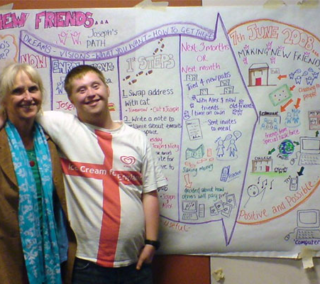
Guidepost 1: Individualize supports for each person
From this…
Notes:
Jen
going from a programmatic, site-based mindset to individualized supports based on person-centered planning. Not always 1:1 support, but a focus on individual interests and goals.
Starts with understanding personal preferences, goals, interests and skills
Emphasizes person-centered planning and discovery, and
Requires creative staffing, intentional grouping, and at times, additional funding

Slide 14
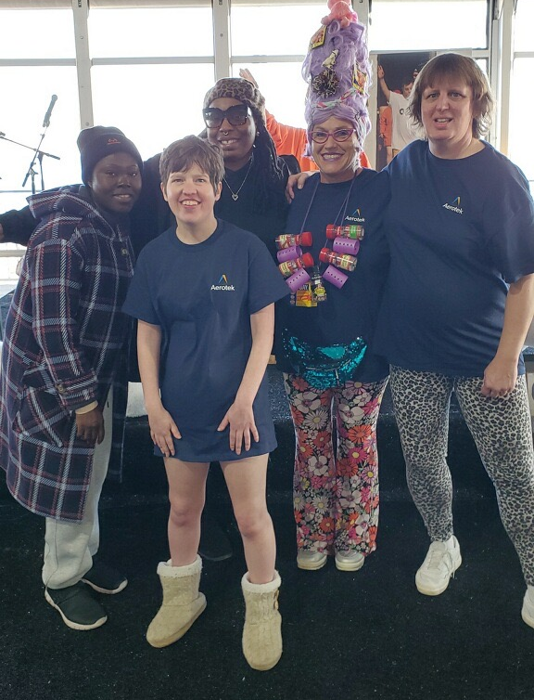
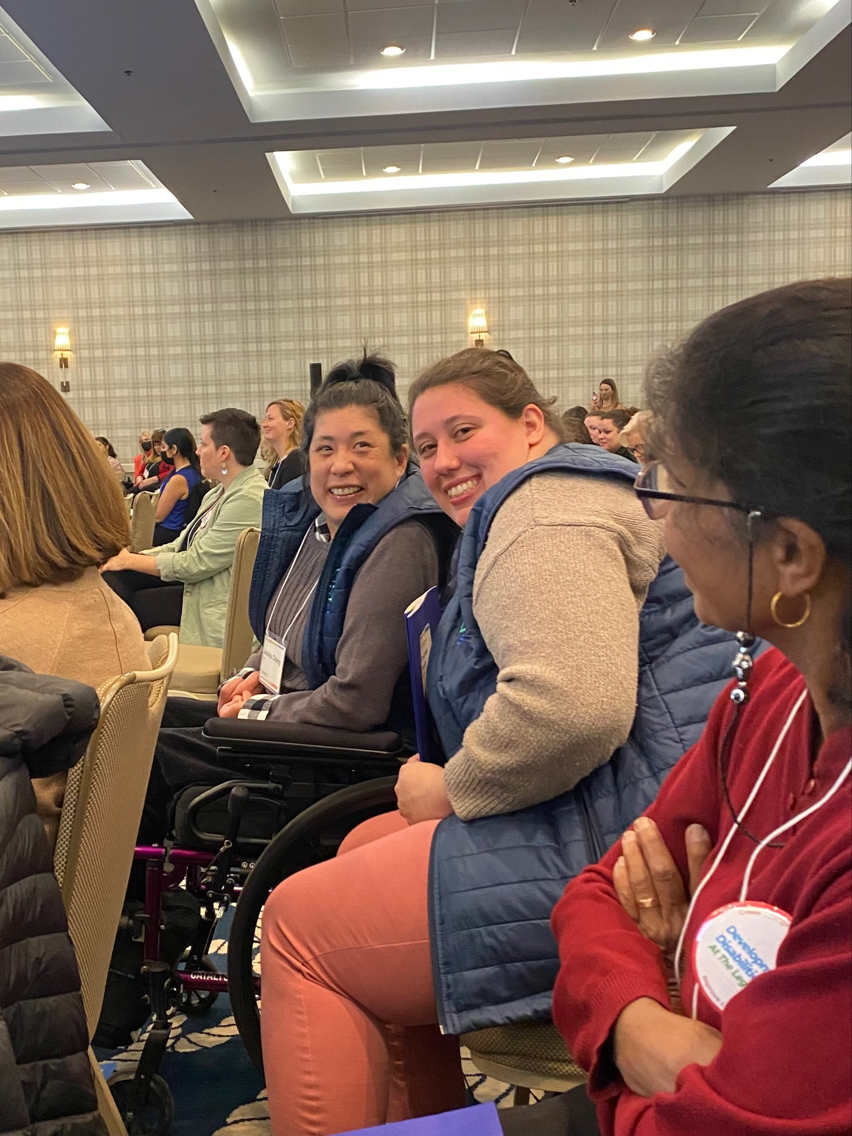
What makes you Unique?
Notes:
Karen

Slide 15
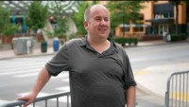
Graham and Jessica’s Individual Lives
Notes:
Karen

Slide 16
Get Curious
Some Good Opening Questions
What is their sport?
Who are their players?
What is their preferred spiritual practice?
Or do they even have one?
What are their routines they like? Or Want?
Who is in their clan? What do they prefer to be called?
Do they like video games
Do they want a partner, what do they look for in a partner?
What type of birthday cake to they like
What is their dream vacation?
Who is their crush? What is their favorite color (not the color they wear, or their room, maybe they didn't choose)
Notes:
Karen

Slide 17

Poll Question #1
(from fidelity scale)
My organization provides training to staff in person-centered planning and/or thinking approaches?
1 Strongly Disagree
2 Disagree
3 Neither Disagree nor Agree
4 Agree
5 Strongly Agree
Notes:
Karen
(Staci will open poll in zoom)

Slide 18
Engagement in the life of one’s community must go beyond simply being physically present in the community to being an active and included member. Ensuring that supports promote community membership and contribution requires
Start with an inclusive setting
Ensure staff presence doesn’t limit connection with the community
Not just presence but membership
Notes:
Jen

Slide 19
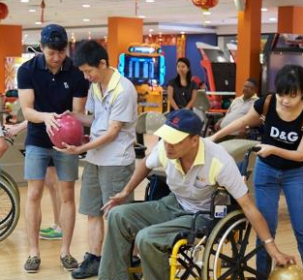
Guidepost 2: Promote community membership and contribution
From this…
Notes:
Jen
Guidepost 2 starts with physically being present in the community but also goes beyond that to participating alongside people with and without disabilities, and making a contribution through paid or volunteer work.
Starting with inclusive settings and activities
Ensure staff presence does not limit community connections
Of the community vs. In the community
Consider personal preferences and goals

Slide 20
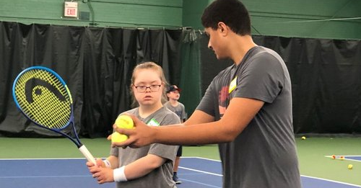
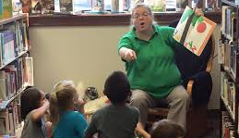
How can you tell the difference between membership and presence?
Notes:
Karen

Slide 21
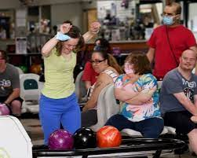
How do they belong?
What are they members of?
Notes:
Karen

Slide 22
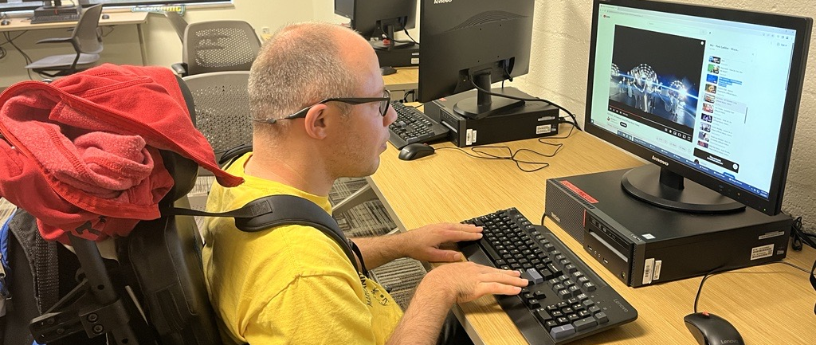
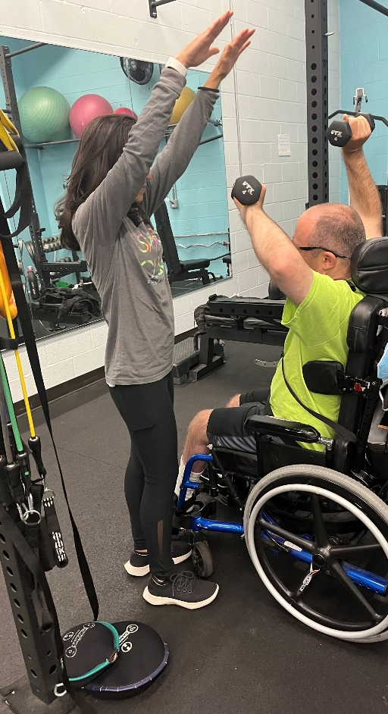
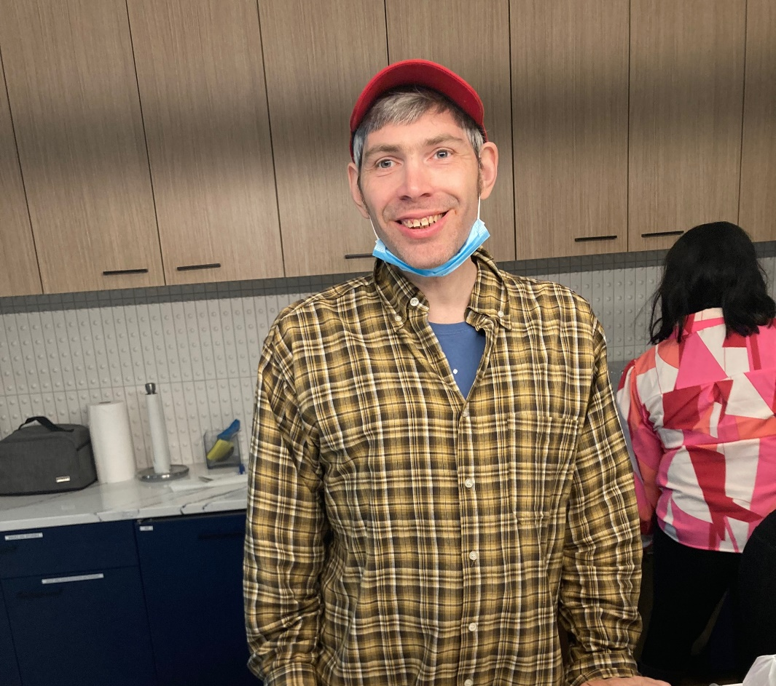
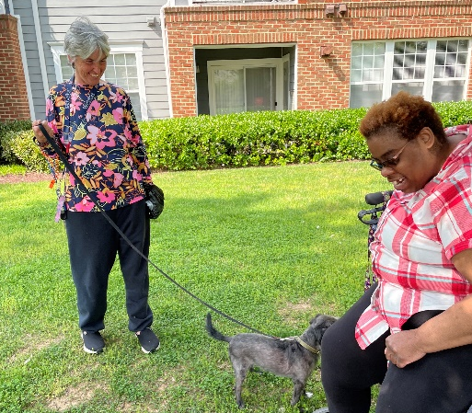
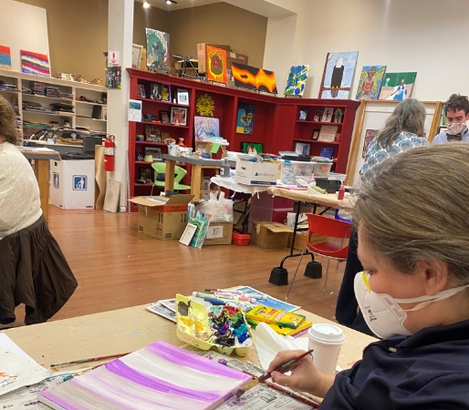
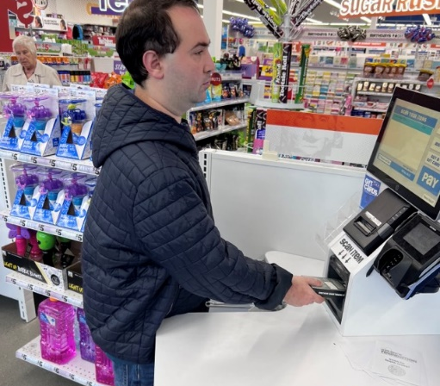
Belonging, contributing and membership

Slide 23
Poll Question #2
My organization provides training to staff on how to identify and build natural supports (in non-work service)
1 Strongly Disagree
2 Disagree
3 Neither Disagree nor Agree
4 Agree
5 Strongly Agree
Notes:
Karen
(Staci will open poll in zoom)

Slide 24
Decreasing Dependence on paid supports
Does not mean no support
Does not mean doing it alone
Means getting out of the way!
Notes:
Jen

Slide 25
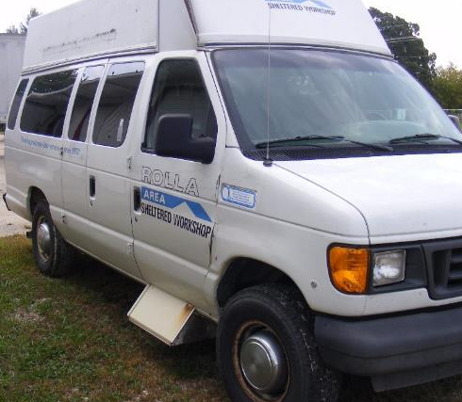
Guidepost 3: Build Skills (Human Capital) and Develop Relationships (Social Capital)
From this…
Notes:
Jen
This means both gaining skills (learning to ride public transit) and social connections (people who can give you a ride) so the person is less dependent on disability service system solutions (like this agency van)
Build human capital by teaching specific skills for community access and employment
Build social capital, which can be used as natural supports

Slide 26
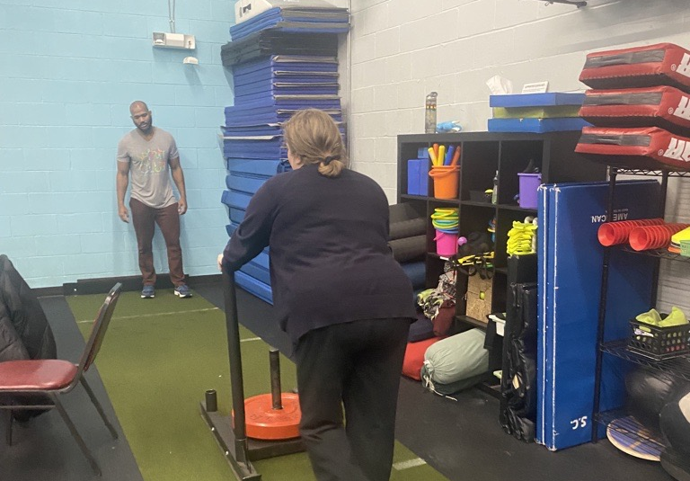
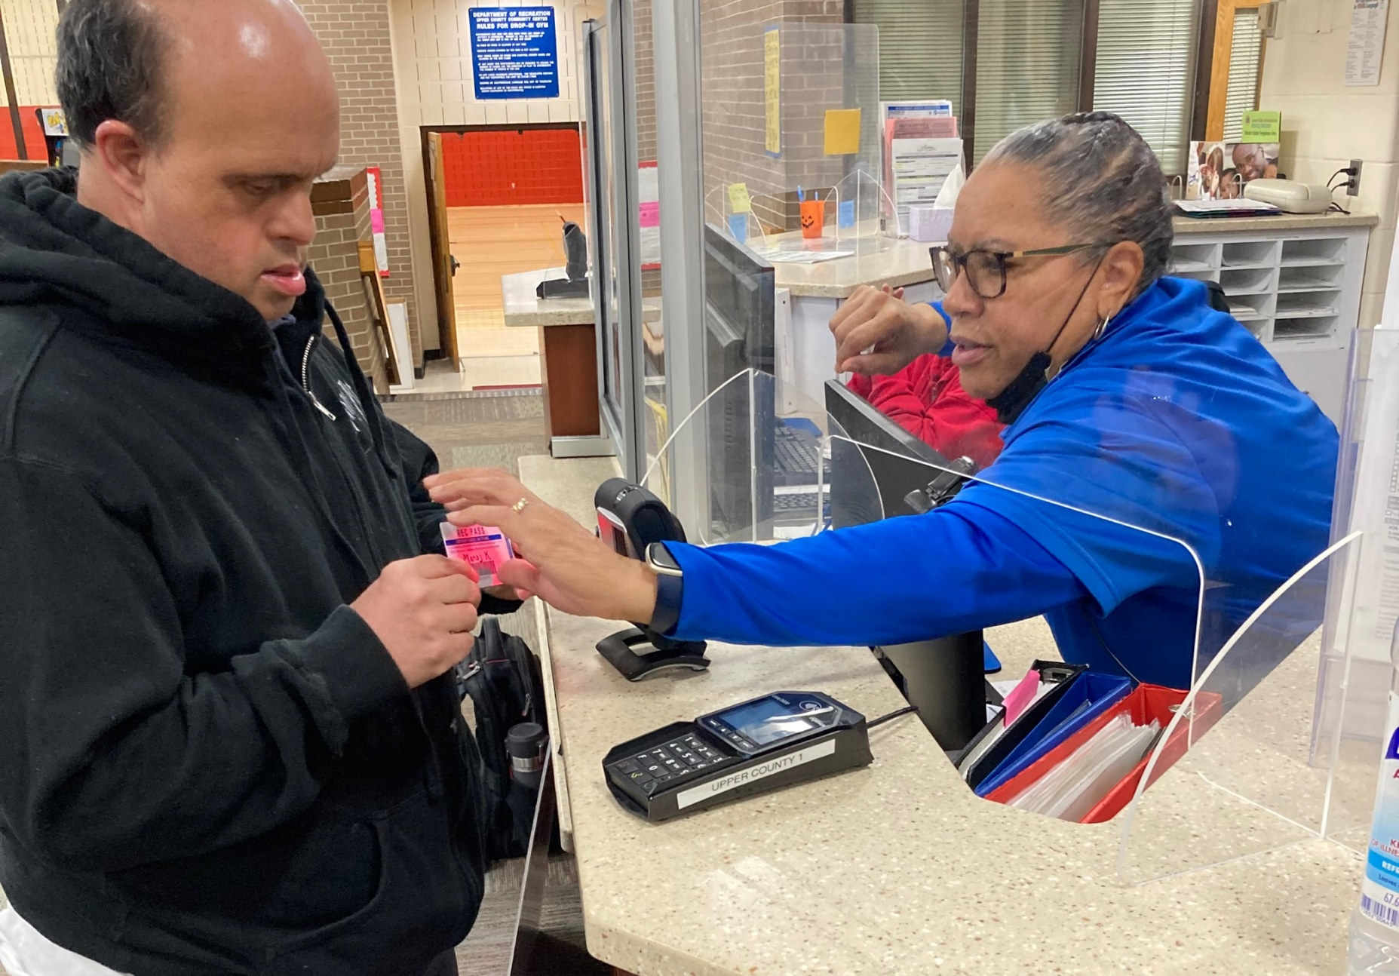
What strategies do you use to get out of the way?
Notes:
Karen

Slide 27
Poll Question #3
(from fidelity scale)
My organization supports individuals to form friendships with people outside the IDD system?
1 Strongly Disagree
2 Disagree
3 Neither Disagree nor Agree
4 Agree
5 Strongly Agree
Notes:
Karen
(Staci will open the poll in zoom)

Slide 28
What is being accomplished?
How do we know when its time to try something new? consider both the individual's goals and the organization's vision
Notes:
Jen

Slide 29
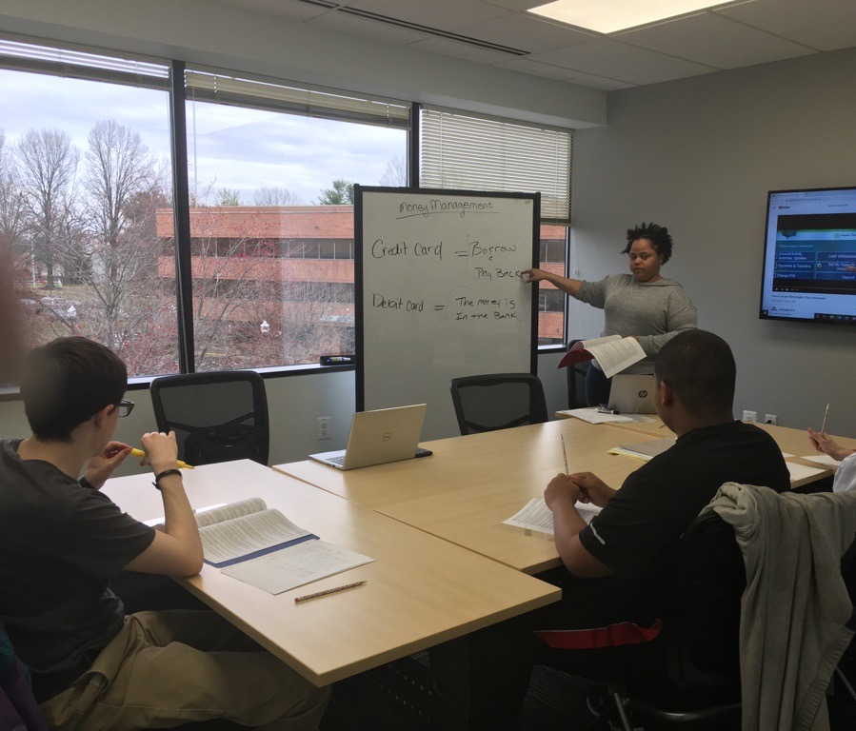

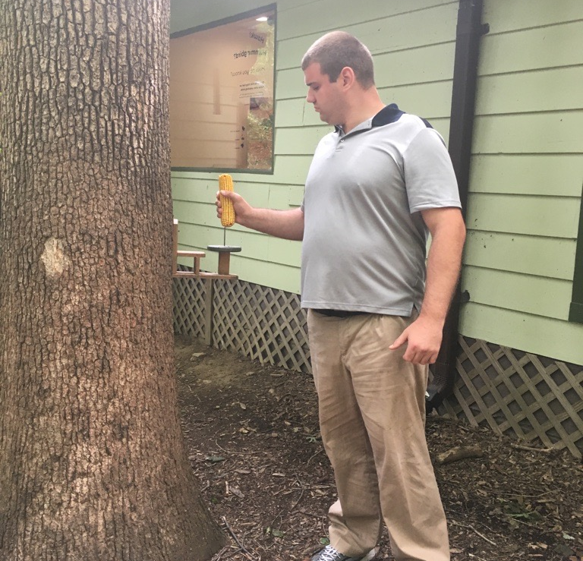
Brett’s Journey to Work
CE as a tool to CIE
Brookside Gardens placing bird feed and cleaning the bird bath
Taking classes to practice deep breathing to calm down when he gets too excited
Played basketball with friends
Worked with a trainer to increase his stamina
Learned to ride bus and metro

Slide 30
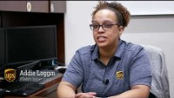
Competitive Integrated Employment is the Outcome

Slide 31
Exercise:
Think of something that you supported someone to do for a long time. Maybe bowling or ice skating?
Discussion: How do you know if it’s time to try something new?
Notes:
Karen

Slide 32
Poll Question #4
(from fidelity scale)
My organization regularly reviews data and feedback collected and uses them to improve supports at the organizational level
1 Strongly Disagree
2 Disagree
3 Neither Disagree nor Agree
4 Agree
5 Strongly Agree
Notes:
Karen
(Staci will open poll in zoom)

Slide 33
Guideposts of Support
Notes:
Karen- wrap up

Slide 34
How will we use these guideposts?
Notes:
Karen-

Slide 35
Questions?
Notes:
Open up for questions

